Slide 1


Service Fabric Workshop - Beyond “Hello World”
dev up - 2016
Presented By: someone that still plays with cars
https://aka.ms/brent-servicefabric-bhworkshop
Notes:
Do introduction

Slide 2
I always wanted to put a sign up on the road to Yale saying, ‘Beware: Deconstruction Ahead.’
Gloria Steinem – American Activist
Notes:
Obligatory quote from someone famous. This seemed as good as anything else.

Slide 3
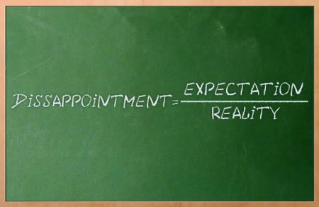
Setting Expectations
Beyond “hello world”
Take things to the next level
Getting Real
Explore problems you will need to solve
Windows and .NET
Others are welcome, but will help will be… limited
Notes:
Introduction
We’re not here to help you install the service fabric SDK. Hopefully you’ve done this, and deployed a simple application. If you haven’t, start doing so now.
Real World Scenarios
We’re going to explore some topics in this workshop that aren’t easily found in the getting started documentation. But these represent topics you are likely going to have to explore at some point if you do anything “of worth” with service fabric. The goal of this workshop is to help arm you with the knowledge that will allow you to take these concepts and flesh them out as you continue your journey.
Windows
Yes, Service Fabric is available on Linux using Java. If this is where your passion it at, then please by all means explore it. However, for today we’ve set up a Windows Server cluster to use for this workshop. Additionally, our ability to help your out in this scenario will be largely academic.
image from: https://thetechbench.wordpress.com/category/client-expectations/

Slide 4
Structure
Complex Clusters & Service Addressability
Stateful Services & Upgrades
Actors & Diagnostics
10-15 talk, 40-60 minutes do
Notes:
We’re breaking today’s workshop into three sections.
Application Deployment: for the first section, we’re going to work on deploying to simple applications to a service fabric cluster hosted in Azure. However, for section we’re going to explore using placement contraints to put the services in specific zones, and using Service Fabric’s reverse proxy in stead of a load balancer to locate a service endpoint to call.
Stateful Services and Upgrades: For the next section, we’re going to implement a stateful service and look at doing upgrades to our services. Controlling the methods we do these upgrades and how to juggle multiple versions of the same service.
Actors and Diagnostics: And finally, we’re going to look at the Service Fabric Actor framework and using its diagnostic capabilities.
Each section will comprise about 10-15 minutes of presentation, followed by a period of “doing”. We have some sample applications already deployed to the cluster with the code available online. But the goal here is for you to start from scratch and build up these scenarios.
Expect to encounter issues. Mistakes are part of the learning process. Expect that some of you may complete each section before time runs out, and that others won’t get a section finished.
And this is a community affair. Don’t be afraid to work with the people around you. While the presenters are here to help, there are fewer of them then there are of you. So working together will help us all learn and progress that much faster.

Slide 5

What’s in the cards
Port Ranges by Suit
Diamonds – 1620-1639
Spades: 1640-1659
Hearts: 1660-1679
Clubs: 1680-1699
Take your “suit range”, and tack on the number for your card. 2-14 (Ace on top)
Example: port 1628
Notes:
We’re using a shared cluster for this workshop. This cluster includes some pre-configured load balanced ports for your services to leverage. Each of you is being allocated a single dedicated port for your applications. We’re going to use the playing cards to assign your ports.
The suit determines a range of ports, the card’s value itself is the port in that range (2-14).
If you don’t have a card yet, please come up during our first “doing” period and grab one.

Slide 6
Complex Clusters
Network Infrastructure Needs
Load balancing (layer-4, layer-7)
Network isolation
Hardware Requirements
Different memory/cpu configuration
Specialized hardware (GPU)
Notes:
Your first service fabric cluster was like a simple affair. But in the real world, its often more complex… combining load balancers, network isolation, different node types, etc…

Slide 7




Our Workshop Cluster
Virtual Network (10.0.0.0/16)
Front End Subnet (10.0.1.0/24)
Back End Subnet (10.0.2.0/24)
Front End
Public IP
Front End Node Types
(VM Scale Set)
Private
Load Balancer
(10.0.2.4)
Three node types
Three Subnets
Public IP w/ Load Balancer
Private IP w/ Load balancer
NSG
NSG
Public
Load Balancer
Back End Node Types
(VM Scale Set)
Management Subnet (10.0.3.0/24)
Management Node Types
(VM Scale Set)
NSG
RDP Jump Box
Public
Load Balancer
Management Public IP
RDP Jump Box Public IP
http://devupsfmgmnt.centralus.cloudapp.azure.com:19080

Slide 8
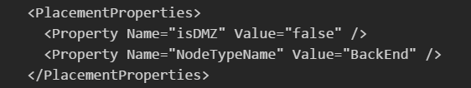
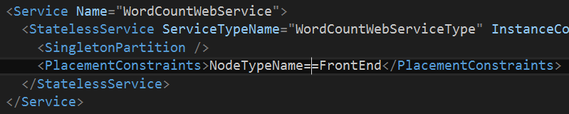
Placement Constraints
Put services where they are needed
Regulatory/security compliance
Hardware specialization
Placement Properties
Declared on the cluster nodes
Placement Constraints
Described by the service

Slide 9
Static vs Dynamic Ports
Static
Good for predictable external access
Constraining for high density environments
Dynamic Assignment
Very “friendly” for neighbors
Need a registry so they can be discovered
Notes:
https://azure.microsoft.com/en-us/documentation/articles/service-fabric-service-manifest-resources/
https://azure.microsoft.com/en-us/documentation/articles/service-fabric-connect-and-communicate-with-services/
https://azure.microsoft.com/en-us/documentation/articles/service-fabric-service-manifest-resources/
http://www.jamessturtevant.com/posts/Integrating-ASPNET-Core-With-Service-Fabric-using-ICommunicationListener/

Slide 10
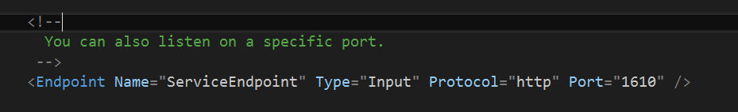
Static Port
Identify Endpoint in Service Manifest
Retrieve from Fabric via serviceContext
Notes:
https://azure.microsoft.com/en-us/documentation/articles/service-fabric-service-manifest-resources/
https://azure.microsoft.com/en-us/documentation/articles/service-fabric-connect-and-communicate-with-services/
https://azure.microsoft.com/en-us/documentation/articles/service-fabric-service-manifest-resources/
http://www.jamessturtevant.com/posts/Integrating-ASPNET-Core-With-Service-Fabric-using-ICommunicationListener/

Slide 11
Static Port
Identify Endpoint in Service Manifest
Retrieve from Fabric via serviceContext
Notes:
https://azure.microsoft.com/en-us/documentation/articles/service-fabric-service-manifest-resources/
https://azure.microsoft.com/en-us/documentation/articles/service-fabric-connect-and-communicate-with-services/
https://azure.microsoft.com/en-us/documentation/articles/service-fabric-service-manifest-resources/
http://www.jamessturtevant.com/posts/Integrating-ASPNET-Core-With-Service-Fabric-using-ICommunicationListener/

Slide 12
Dyanmic Port
Identify Endpoint in Service Manifest
Retrieve from Fabric via serviceContext
Notes:
https://azure.microsoft.com/en-us/documentation/articles/service-fabric-service-manifest-resources/
https://azure.microsoft.com/en-us/documentation/articles/service-fabric-connect-and-communicate-with-services/
https://azure.microsoft.com/en-us/documentation/articles/service-fabric-service-manifest-resources/
http://www.jamessturtevant.com/posts/Integrating-ASPNET-Core-With-Service-Fabric-using-ICommunicationListener/

Slide 13
Reverse Forwarder

Slide 14
Workshop Time!
App Placement
& Discovery
Content © Microsoft
Notes:
So lets take a look at two different clusters
Local machine (with SDK)
pull up the local copy of the portal http://localhost:19080
Cluster Services
Failover Manager: deals with nodes being added or removed from the cluster. Redistributing services as needed
Cluster Manager: works with the failover manager to place services on nodes
Naming Service: allows for discovery of services and their endpoints
Node distribution
Services (only addressable from within the cluster)
Process threads
Azure Hosted
Resource group – examine resources
Portal
Image Service: the application/service store. register and store packages. Doesn’t appear on the local cluster since its on the local disk

Slide 15
Interested in More?
https://aka.ms/brent-servicefabric-bhworkshop
Content © Microsoft
Notes:
Too many learning materials to list here. I’ve put some of my favorites, along with a link to his presentation and some related materials up on GitHub.. Enjoy and check back for updates as things continue to mature.

Slide 16

Thank you!
https://aka.ms/brent-servicefabric-bhworkshop
Brent Stineman
DX/TED, Azure Specialist, Cloud Evangelist
Email: brestin@microsoft.com
Twitter: @brentcodemonkey
Web: http://brentdacodemonkey.wordpress.com
→
Creating quality bugs since 1992!
Notes:
Image Courtesy of Brent.
Purple dye all over his face is courtesy of his daughter

Slide 17
























PLATINUM
thank you dev up Conference 2016 Sponsors !
GOLD
SILVER

Slide 18
dev up Conference 2016 Attendee Party
Ryse Nightclub
October 21st Friday 5:15 – 10:15
Food, Drinks, Games, and Fun!

